Slide 1
COMPREHENSIVE TECHNICAL REFERENCE
Data Structures & Algorithms Master Class
Systematic guide to memory models, asymptotic bounds, sorting paradigms, graph theory, dynamic programming, and interview patterns.
17 Technical Modules
Memory & Complexities
System Design Tradeoffs
System Architecture & Engineering Deep Dive
v3.0 • 2026 Edition

Slide 2

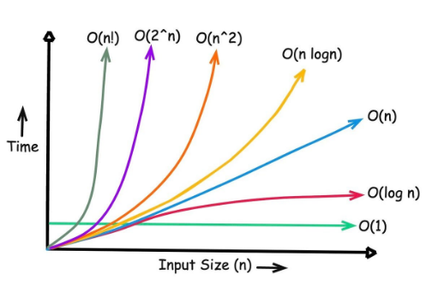
FOUNDATIONS & COMPLEXITY
Asymptotic Notation & Growth Models
Big-O (O) • Upper Bound
Guaranteed worst-case runtime ceiling. Defines strict maximum operations for size n.
Big-Omega (Ω) • Lower Bound
Best-case minimum execution baseline. Represents optimal input efficiency floor.
Big-Theta (Θ) • Tight Bound
Exact asymptotic rate match when upper and lower bounds converge on same order.

Slide 3
MEMORY ARCHITECTURE
Arrays, Vectors, & Linked List Mechanics
Contiguous Memory (Arrays)
O(1) Random Access
Pointer Chasing (Linked Lists)
O(1) Node Insertion
Cache Locality: High L1/L2 cache hit ratio via sequential prefetching.
Heap Allocation: Non-contiguous nodes connected via memory pointers.
Dynamic Vectors: Amortized O(1) append via 2x array resizing capacity.
Costly Inserts: O(n) element shifts for interior index modifications.
Cache Misses: Random heap access degrades hardware prefetching.
Pointer Overhead: Additional 8-bytes per node on 64-bit platforms.
Index = Base_Addr + (Element_Size * i)
struct Node { T data; Node* next; };

Slide 4
ARRAY TRAVERSAL PATTERNS
Two Pointers & Sliding Window Mechanics
Opposite Ends
Fast & Slow
Dynamic Boundaries
Converging Pointers
Floyd's Cycle Algorithm
Sliding Window
Left and Right pointers move inward toward center on sorted sequences.
Slow pointer advances 1 step while Fast advances 2 steps to detect loops.
Expand right boundary to satisfy condition, shrink left boundary to optimize.
•
•
•
Two Sum in O(n) time
Linked List Cycle Start
Longest Substring Without Repeats
•
•
•
Container with Most Water
Find Duplicate Number
Minimum Window Substring
Space: O(1) Auxiliary
Time: O(n) Detection
Time: O(n) Amortized

Slide 5
ABSTRACT DATA TYPES
Stacks, Queues, & Monotonic Variants
Structure | Order | Push / Pop | Key Algorithmic Application
Stack | LIFO | O(1) | Call stacks, Expression evaluation, Parsing
Queue | FIFO | O(1) | BFS traversal, Task schedulers, Buffers
Monotonic Stack | Sorted | O(1) amortized | Next Greater Element, Histogram Area
Deque / Sliding Max | Double Ended | O(1) | Sliding window maximum in O(n) overall
Monotonic Stack Invariant
Elements inside the stack maintain strict increasing or decreasing order. Popped elements yield instant range boundaries.
while(!stk.empty() && curr > stk.top()):
val = stk.pop()
resolveNextGreater(val, curr)

Slide 6
EXECUTION & SEARCH TREES
Recursion, Call Stacks, & Backtracking
Stack Frame Overhead
O(d) Call Depth
Backtracking State Pruning
Depth-First State Search
Every recursive call allocates local variables, return addresses, and parameters onto call stack memory.
Explores decision trees systematically, backtracking immediately when constraint check fails.
• Base Case Required: Prevents infinite recursion stack overflow.
• Choose - Explore - Unchoose Pattern: Modifies state in-place.
• Tail Call Optimization: Reuses stack frame when recursive call is last statement.
• Classic Applications: N-Queens, Sudoku, Subsets, Permutations.
Stack frame = Registers + Locals + Ret Addr
state.add(choice); dfs(); state.remove(choice);

Slide 7
ALGORITHM COMPARISON
Core Sorting Paradigms & Complexity Matrix
Algorithm | Best Time | Average Time | Worst Time | Aux Space | Stable? | Primary Paradigm
Quick Sort | O(n log n) | O(n log n) | O(n²) | O(log n) | No | Divide & Conquer (In-place pivot)
Merge Sort | O(n log n) | O(n log n) | O(n log n) | O(n) | Yes | Divide & Conquer (External merge)
Heap Sort | O(n log n) | O(n log n) | O(n log n) | O(1) | No | Binary Max-Heap Selection
Timsort | O(n) | O(n log n) | O(n log n) | O(n) | Yes | Hybrid Insertion + Merge Runs
Counting Sort | O(n + k) | O(n + k) | O(n + k) | O(k) | Yes | Non-Comparison Key Frequency

Slide 8
LOGARITHMIC LOOKUP
Binary Search & Predicate Search Spaces
Index Search
Answer Range Search
Discrete Array Lookup
Binary Search on Answer
Eliminates half the remaining elements per iteration on sorted arrays.
Searches monotonic continuous value ranges [Min_Val, Max_Val] via boolean feasibility function.
•
Lower Bound: First index where arr[i] >= target
•
Upper Bound: First index where arr[i] > target
•
Capacity to Ship Packages within D Days
•
Koko Eating Bananas Speed
mid = low + (high - low) / 2
if isValid(mid): high = mid else: low = mid + 1

Slide 9

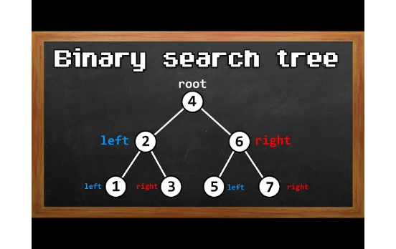
HIERARCHICAL STRUCTURES
Binary Search Trees & Self-Balancing Mechanics
BST Invariant
Left subtree keys < Root key < Right subtree keys. Inorder yields sorted sequence.
AVL Trees (Strict Balance)
Height difference between subtrees ≤ 1. Restores balance via tree rotations.
Red-Black Trees (Relaxed)
Node color rules guarantee longest path ≤ 2x shortest path. Powers std::map.

Slide 10
PRIORITY STRUCTURES
Binary Heaps & Priority Queue Operations
Array Representation
Restructuring
Streaming Data
Complete Binary Tree
Sift-Up & Sift-Down
Top-K Stream Patterns
Stored compactly in contiguous arrays without child node pointers.
Swaps elements along parent-child paths to preserve Max-Heap / Min-Heap property.
Maintains Min-Heap of size K to process massive streaming datasets in memory.
•
•
•
Left Child = 2i + 1
Insert: O(log n) Sift-Up
Kth Largest Element
•
•
•
Right Child = 2i + 2
Extract Top: O(log n) Sift-Down
Merge K Sorted Lists
•
•
Build Heap: O(n) Floyd's Algo
Parent = (i - 1) / 2
Space: Zero Pointer Overhead
Time: O(1) Top Access
Memory: O(K) Fixed Size

Slide 11
NETWORK EXPLORATION
Graph Representations & Traversal Mechanics
Breadth-First Search (BFS)
Queue-Based Layering
Depth-First Search (DFS)
Stack / Recursion Path
Explores graph nodes outwards level-by-level from origin node.
Traverses deeply along each branch before backtracking.
• Unweighted Shortest Path: Guarantees minimum edge hops.
• Path Discovery: Solves maze paths, cycle detection, topological ordering.
• Space Complexity: O(V) queue storing frontier boundary.
• Space Complexity: O(H) call stack memory depth.
Time Complexity: O(V + E)
Time Complexity: O(V + E)

Slide 12
WEIGHTED GRAPH PATHS
Shortest Path Algorithms Matrix
Algorithm | Time Complexity | Space | Negative Weights? | Core Mechanism / Use Case
Dijkstra's Algo | O((V + E) log V) | O(V) | No | Greedy edge relaxation via Min-Heap. GPS maps.
Bellman-Ford | O(V × E) | O(V) | Yes | Relaxes all edges V-1 times. Detects negative cycles.
Floyd-Warshall | O(V³) | O(V²) | Yes (No cycles) | All-Pairs Shortest Path 2D Dynamic Programming.
A* Search | O(E) worst | O(V) | No | Heuristic Priority f(n) = g(n) + h(n) pathfinding.

Slide 13
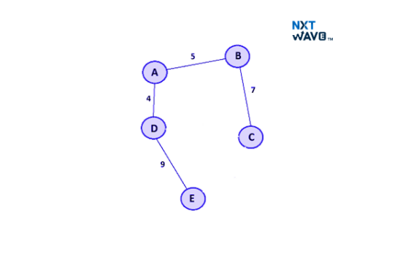
GRAPH OPTIMIZATION
Minimum Spanning Trees & Topological Sorting
Kruskal's MST
Sorts edges by weight, adds valid edges using Union-Find to avoid cycles.
Prim's MST
Grows connected component node-by-node selecting minimum weight cut edge.
Kahn's Algorithm (Topological)
Processes zero in-degree nodes via queue for DAG dependency compilation.

Slide 14
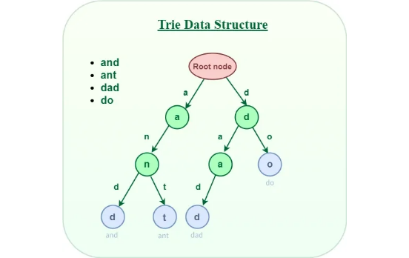
TEXT PROCESSING
Pattern Matching, Hashing, & Tries
KMP Search (LPS Table)
Precomputes Longest Proper Prefix-Suffix array to skip re-scanning text characters.
Rabin-Karp Rolling Hash
Sliding polynomial rolling hash computes string window hashes in O(1) time.
Prefix Trie & Aho-Corasick
Retrieves string prefixes in O(L) time. Aho-Corasick matches multi-patterns simultaneously.

Slide 15
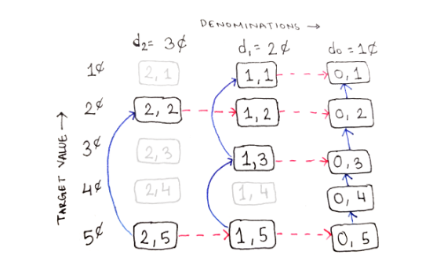
OPTIMIZATION PARADIGMS
Dynamic Programming Sub-Patterns & Grids
0/1 Knapsack Pattern
Item state DP[i][w] = max choice between taking or skipping current item weight.
Longest Common Subsequence
2D matrix state transition comparing string characters. Forms core of git diff tools.
State Space Compression
Reduces 2D grid DP memory from O(N × M) down to O(M) using rolling 1D rows.

Slide 16
ADVANCED RANGE STRUCTURES
Disjoint Set Union & Range Query Trees
Disjoint Sets
Prefix Sums
Interval Trees
Union-Find Structure
Fenwick Tree (BIT)
Segment Tree
Tracks dynamic component connectivity with near-constant performance.
Binary Indexed Tree storing cumulative frequency sums using bitwise lowbit logic.
Binary tree dividing array intervals into sub-segments for arbitrary range functions.
•
•
•
• Path Compression
• Point Update: O(log N)
• Range Query: O(log N)
•
•
•
• Union by Rank / Size
• Prefix Query: O(log N)
• Lazy Propagation Update
Time: O(α(N)) Inverse Ackermann
Space: O(N) Array Compact
Space: O(4N) Array Bounds

Slide 17
TECHNICAL SYNTHESIS
Algorithm Pattern Recognition Framework
Input Constraints
Subproblem Clues
Tradeoff Mastery
n ≤ 20 → O(2ⁿ) Backtracking.
n ≤ 10⁵ → O(n log n) Sort/Tree.
n ≤ 10⁷ → O(n) Two Pointers/Hash.
Contiguous Subarray → Sliding Window.
Shortest Distance → BFS / Dijkstra.
Min/Max Choice → Dynamic Programming.
Precompute with Hash Table for O(1) lookup speed at cost of extra memory space.
Ready for Technical System Architecture & Interviews
Master Guide Complete
Apply these data structures & algorithmic primitives to construct scalable software.

Slide 18





Image Sources
https://miro.medium.com/1*ENAP16Z-YXbzEebQllXFYA.jpeg
Source: medium.com
https://pages.cs.wisc.edu/~xiaotian/binary_search_diagram.jpg
Source: pages.cs.wisc.edu
https://d14qv6cm1t62pm.cloudfront.net/ccbp-website/Blogs/home/minimum-spanning-tree-image-6.jpg
Source: www.ccbp.in
https://media.geeksforgeeks.org/wp-content/uploads/20250417113106950395/Triedatastructure1.webp
Source: www.geeksforgeeks.org
https://miro.medium.com/v2/resize:fit:1400/1*QUFPgsjvWDcqOlra7Omsjg.png
Source: medium.com

